Slide 1
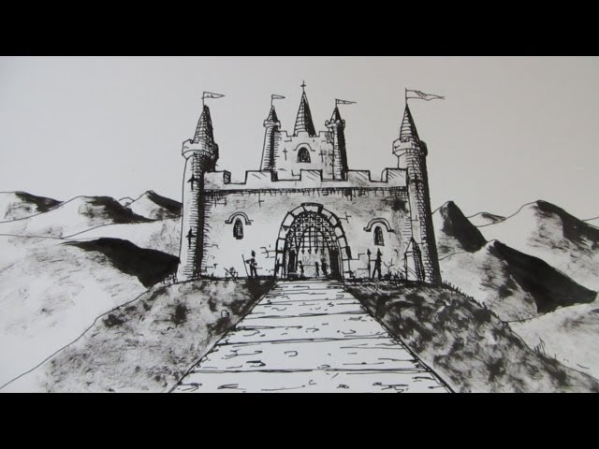
Famous kings of india

Slide 2
1
Chandragupta Maurya 321bce–. 297 bce
2
Ashoka 265 bce–238 bce
3
Vikramaditya 77bce- 15bce
4
Maharana Pratap 1 March 1572 – 19 January 1597
Efforts by Bhavika Dhingra

Slide 3
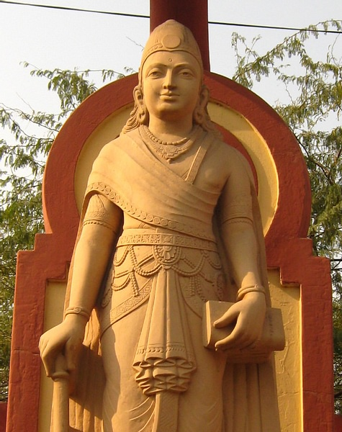
ChandraGupta maurya
Personal life
Empire
Born in Patna in 340 bce.
Son of prince Sarvarthasiddhi of the Nanda Kingdom.
He was the first powerful ruler of Mauryan dynesty.
His empire extended from Magadha (Bihar) to Prayag (Allahabad)

Slide 4
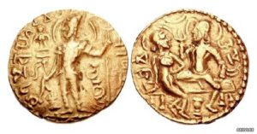
Basic Life
Chandragupta
Marriage
sources
King of Kings
Most prominent ruler of Mauryan dynasty.
He was the first emperor who united the predominant part of India under one empire itself.
He is credited with saving the country from maladministration and freeing it from foreign domination
Married to Kumara Devi
Married to Kumara Devi of Lichchhvi tribe to strengthen foundations between neighbouring and flourishing kingdoms.
Archaeological and Literary Sources
Coins picturing him and his wife.

Slide 5
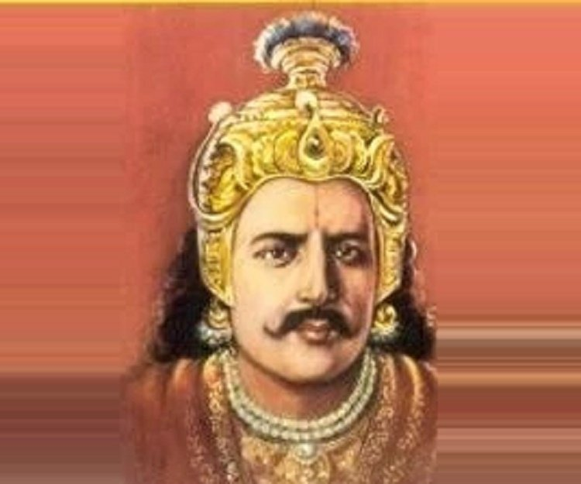
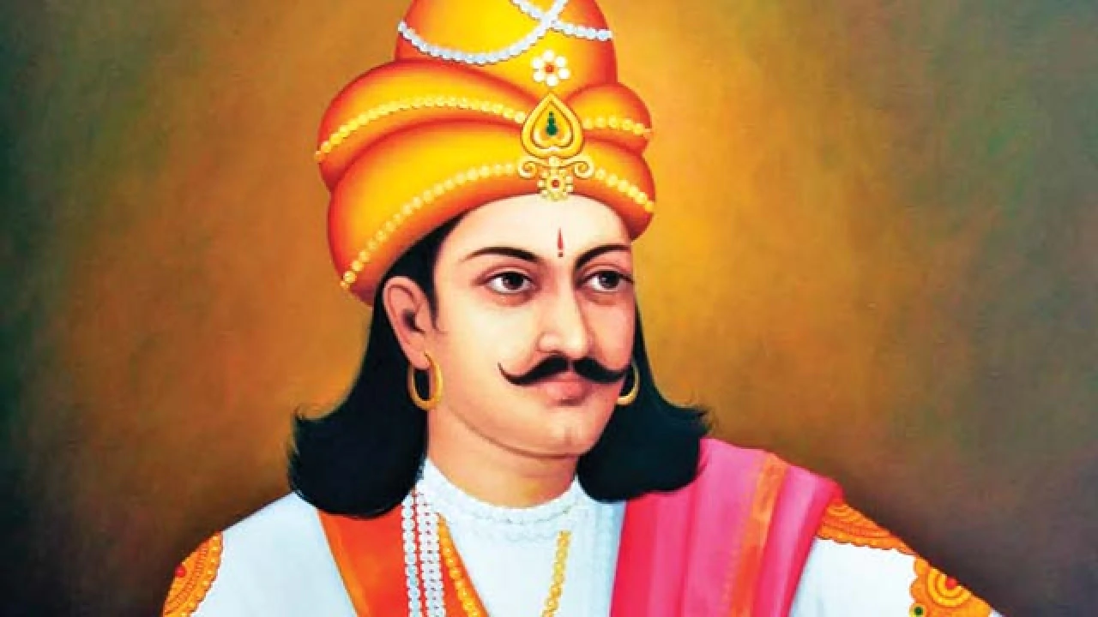
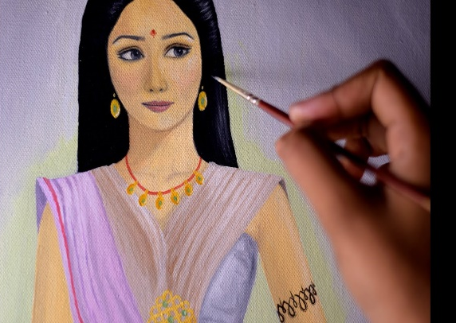
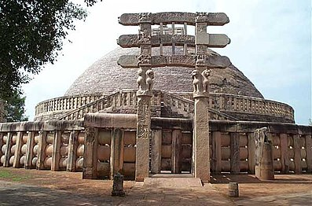
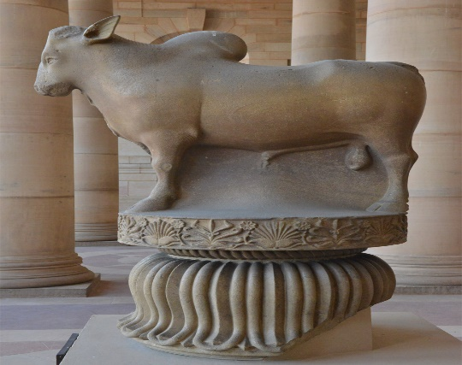
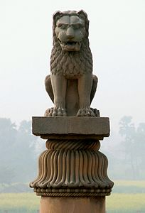
Ashoka
The last major emperor in the mauryan dynesty of india .
Was the son of and Ashoka Ruled from 265–238 bce
Art and architecture
Ashoka is well known for his buildings, pillars, stupas and inscriptions. These monuments are very famous for their perfections.
BINDUSARA
SUBHADRANGI

Slide 6

The wheel which adorns the flag of india, has kept his memory green. Lord of vast empire. after a great victory on the battlefield. ASHOKA grew sick of violence and took an oath to never fight again…

Slide 7
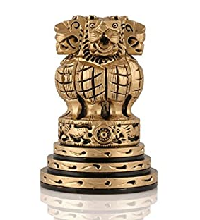
Later when India got independence his symbol was chosen for its national emblem as the country continued to carry ashoka’s legacy of peace , secularism and righteousness.

Slide 8
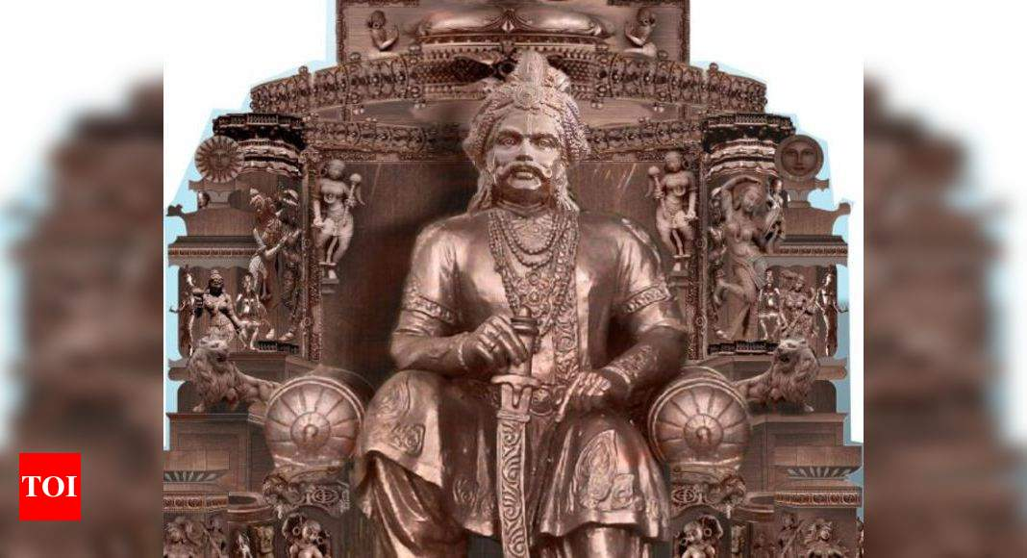
Vikramaditya
Vikramaditya was born in 102 bce. He Reign from 77 bce – 15 bce.
An ideal king who was as wise as he was brave and strong. Matchless in war, matchless in forgiving, an excellent ruler. he won the hearts of his people.
VikramAditya means the sun of valour, That is, the one who is powerful as the sun.

Slide 9
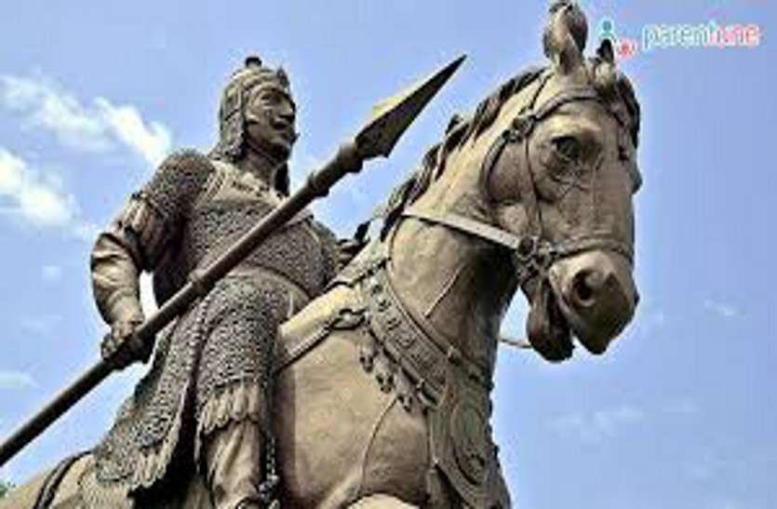
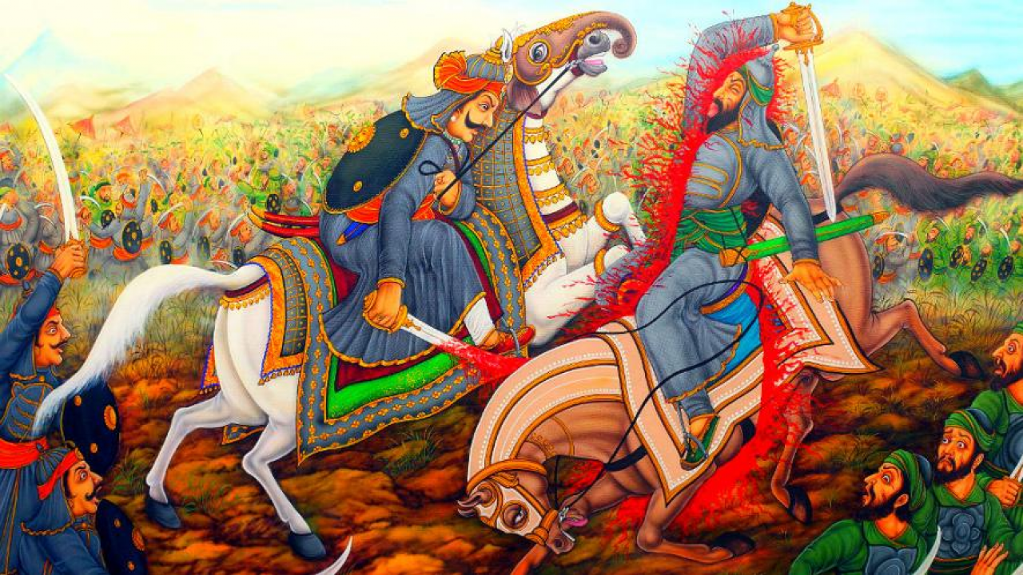
Maharana Pratap
Maharana Pratap was born in a Hindu Rajput family. He was born to Udai Singh and Jaiwanta Bai
Maharana Pratap, was the 13th king of Mewar, Rajasthan.
He was titled as "Mewari Rana" and was notable for his military resistance against the expansionism of the Mughal Empire.
Battle of haldi Ghati

Slide 10


